Slide 1
17.1 Major Attributes of Quality for WebApps
Introduction
- User perceptions of "goodness" vary widely among WebApp users.
- Importance of balancing user preferences with technical characteristics of quality.
Key Quality Attributes
1. Usability
- Ease of use and user-friendliness.
- Accessibility for diverse user groups.
2. Functionality
- Features and capabilities that meet user needs.
- Appropriate tools and content for tasks.
3. Reliability
- Consistent performance and uptime.
- Error handling and recovery mechanisms.
4. Efficiency
- Resource optimization for better performance.
- Fast load times and minimal resource consumption.
5. Maintainability
- Ease of updates, enhancements, and bug fixes.
- Clear documentation and modular design.

Slide 2
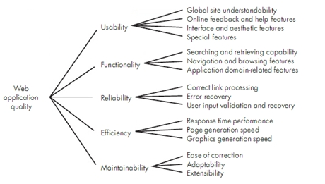
Extended Attributes
6. Security
- Protection of sensitive data and user privacy.
- Compliance with security protocols and standards.
Conclusion
- A comprehensive approach to designing and maintaining WebApps that incorporates these attributes can lead to high-quality systems that are well-received by users.

Slide 3
Key Quality Attributes
1. Usability
- Ease of use and user-friendliness.
- Accessibility for diverse user groups.
2. Functionality
- Features that fulfill user needs.
- Appropriate tools and content.
3. Reliability
- Consistent performance and uptime.
- Robust error handling and recovery.
4. Efficiency
- Resource optimization for better performance.
- Fast load times and minimal resource use.
5. Maintainability
- Ease of updates and bug fixes.
- Clear documentation and modularity.
6. Security
- Protecting sensitive customer information.
- Rebuffing unauthorized access and thwarting attacks.
7. Availability
- Measure of time the WebApp is operational.
8. Scalability
- Ability to handle growing user volumes efficiently.
- Ensuring responsiveness under varying loads.
9. Time-to-Market
- Speed of deployment as a business quality measure.
- The first WebApp in a market segment often captures more users.
Conclusion
- Emphasizing these attributes in the design and delivery of WebApps will enhance user satisfaction and overall success in the competitive digital landscape.

